Slide 1
Color’s Effect On Decision Making

Slide 2
Purpose of the Investigation
We wanted to look at the differences
between black & white, colored, and
digitally enhanced photographs and the
Impact they have on decision making.
Our reason for choosing this problem is to
further investigate previous research that
seems to show that color is an important
factor when using visuals in litigation.

Slide 3
Background to the Investigation: Big Picture
Big Picture: We chose our particular image and manipulation because, from prior research, we learned that photographs are very effective in conveying messages. They are effective because they have an intense visual impact. Also, changing color or color intensity can influence the way individuals perceive the photograph. However, in conducting our research, we had to be cautious not to over manipulate the photo.
Golan
Fielder
Feigenson & Dunn

Slide 4
Background to the Investigation
Golan (2008)
Relation to our Research
Visual images have started to dominate the court room, giving contending parties even more powerful ways of visualizing their claims in courts.
Photographs are very different from other visual displays. They record details more accurately and communicate ideas more efficiently than other verbal testimony or visual images.
  This article gave us the idea to use a photograph in our study instead of another visual display, such as a cartoon, drawing, or sketch. The research explained that photographs have a greater visual impact.

Slide 5
Background to the Investigation
Fiedler (2004)
Relation to our Research
Relation to our Hypotheses
Color can improve a jury’s recognition.
High contrast colors can cause juries to pay more attention to a particular visual display.
Certain combinations of colors can improve a message or convey a false message.
Color can also help the jury understand or remember the visual display better.
This article proved to us that color would be a very effective aspect to manipulate in our visual display for our research.
This information lead us to our hypotheses that a color visual display will be more influential than a black & white visual display. This is especially true for high contrast colors

Slide 6
Background to the Investigation
Feigenson & Dunn (2003)
Relation to our Research
A simple effect study is a study that only manipulates one aspect or variable in the research.
It is wise to only manipulate one aspect of a visual display in litigation cases, because If you manipulate a visual display too much it can lead to many legal problems and a judge can rule out the image.
In our research we conducted a simple effects study by manipulating only one aspect of the visual display that we choose. The aspect that we manipulated was color.
We chose to only manipulate the color of our image because we did not want our visual display to be excessively manipulative, so it could be used in a litigation case.

Slide 7
Hypothesis & Predictions
Fiedler (2004)
A digitally enhanced photo will
influence an individual’s
decision in a court case more
than a black & white photo,
and a regularly colored photo in favor of the victim.
Color can improve a jury’s recognition.
High contrast colors can cause juries to pay more attention to a particular visual display.
Certain combinations of colors can improve a message or convey a false message.
Color can also help the jury understand or remember the visual display better.
An individual’s decisions will
be more influenced by a
digitally enhanced photo
rather than a black & white
or regularly colored photo.
A regularly colored photo
will influence an individual’s
decision and have a greater
impact on that decision
than a black & white photo.

Slide 8
Methods: Designs
 | Black & White | Color | Digitally Enhanced Color
Photo 1 | 10 | 10 | 10
Photo 2 | 10 | 10 | 10

Slide 9
Methods: Materials
Three separate photographs of a victim’s injuries:
  Black & white
  Colored
  Digitally-enhanced colored
Three surveys:
  Demographic questionnaire
  Rating of agreement
  Rating of photograph Influence
Libeck V. Mc Donald’s case brief.

Slide 10
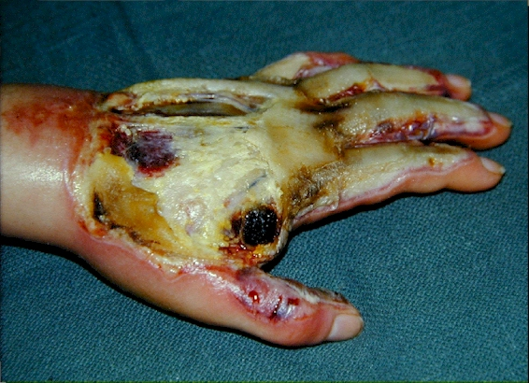
Picture: Black & White

Slide 11
Picture: Colored

Slide 12
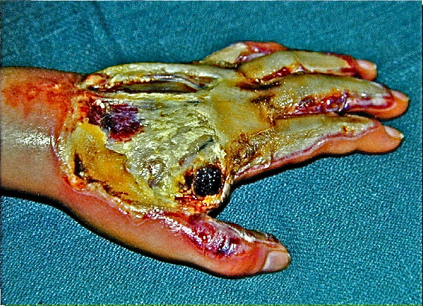
Picture: Digitally-enhanced colored

Slide 13
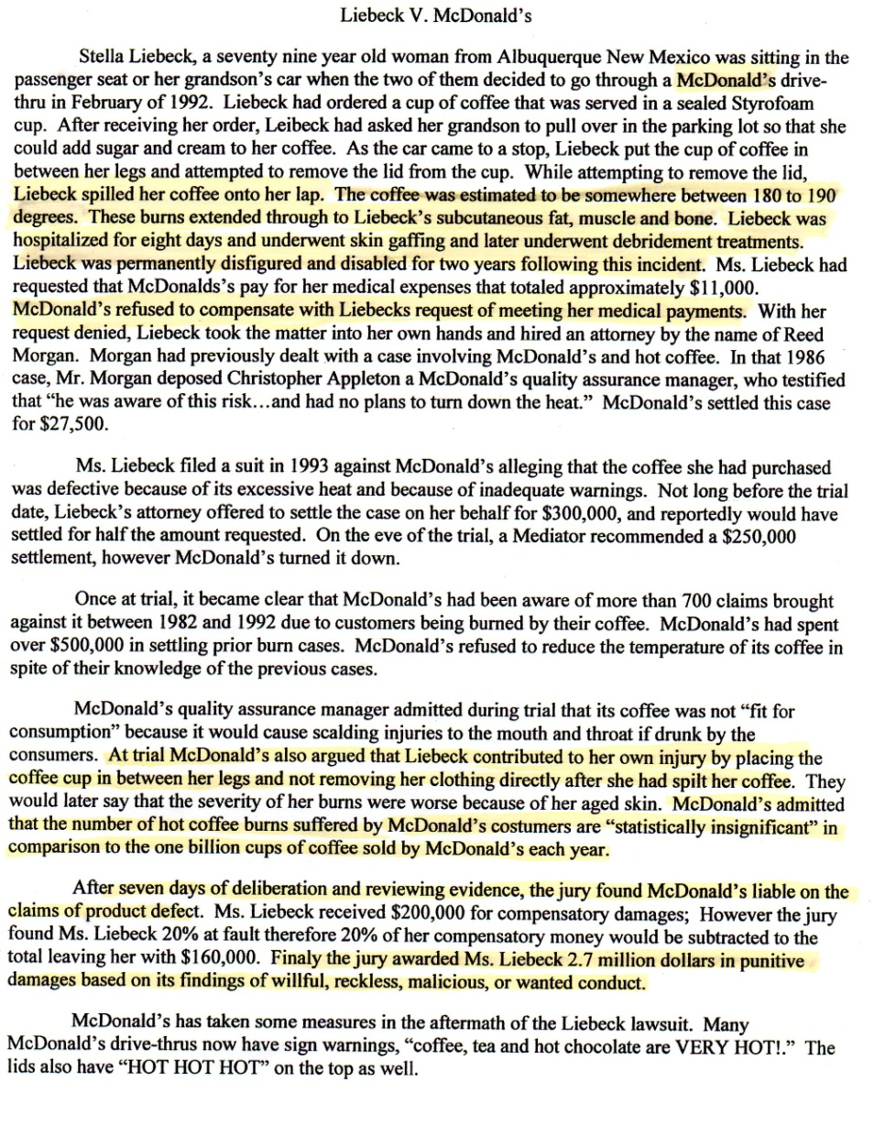
Libeck V. McDonald’s Case Brief
Liebeck spilled her coffee onto her lap. The coffee was estimated to be somewhere between 180 to 190 degrees. These burns extended through to Liebeck’s subcutaneous fat, muscle, and bone. Libeck was hospitalized for eight days and underwent skin grafting and later underwent debridement treatments. Libeck was permanently disfigured and disabled for two years following this incident.
McDonald’s refused to compensate with Liebeck’s request of meeting her medical payments.
At trial McDonald’s also argued that Liebeck contributed to her own injury by placing the coffee cup in between her legs and not removing her clothing directly after she had spilt her coffee.
McDonald’s admitted that the number of hot coffee burns suffered by McDonald’s costumers are “statistically insignificant” in comparison to the one billion cups of coffee sold by McDonald’s each year.
After seven days of deliberation and reviewing evidence, the jury found McDonald’s liable on the claims of product defect… Finally the jury awarded Ms. Liebeck 2.7 million dollars in punitive damages on its findings of willful, reckless, malicious, wanted conduct.

Slide 14
Methods: Materials
Survey Questions
  Survey 1
  Question One: Rate the degree to which you agree or disagree with the final outcome of 2.7 million dollars, given to the victim for compensation of her injuries.
  Question Two: Rate the degree to which the photograph you were provided had an effect on your decision.
  Survey 2
  Question One: Rate the degree to which the second photograph you were provided had an effected your decision.

Slide 15
Methods: Materials
Scale: Rating of agreement for survey one question one.
Disagree
Agree
-5 -4 -3 -2 -1 0 1 2 3 4 5
Scale: Rating of photograph influence for survey one question two and survey two question one.
Not Effective
Extremely Effective
-5 -4 -3 -2 -1 0 1 2 3 4 5

Slide 16
Methods: Materials
Packet for participant’s:
  Packet1: Digitally enhanced color/Color
  Packet2: Digitally enhanced color/Black & White
  Packet3: Color/Black & White
  Packet4: Color/Digitally enhanced color
  Packet5: Black & White/Color
  Packet6: Black & White/ Digitally enhanced color
All packet’s included:
  All three surveys
  The case brief
  Two randomized photographs as listed above

Slide 17
Methods: Materials
iPhoto
  Used to manipulate the colored photograph creating the digitally enhanced photograph.
  When manipulating the visual display, we changed:
    Exposure: from 0 to .88.
    Contrast: from 0 to 29.
    Highlights: from 0 to 50.
    Shadows: from 0 to 50.
    Saturation: from 50 to 75.
    Sharpness: 0 to .80.

Slide 18
Methods: Subjects
45 Females
15 Males
Ages 19-31
Mean Age: 21.35
All students were randomly sampled from California State University, Chico.

Slide 19
Methods: Procedure for researchers
Presented the participants with a packet at random.
Participants were instructed to:
  Not read ahead.
  Fill out two surveys that would correspond with two photos.

Slide 20
Methods: Procedures for participant's
Participant’s filled out demographic survey.
Participant’s read the Libeck V. McDonald’s case brief.
Participant’s looked at the first photograph in their particular packet, then answered survey one based on the photograph.
Participant’s looked at second photograph in their particular packet, then answered survey two.

Slide 21
Results: Data Reduction
Data corresponding to the information we received from participant’s was entered into SPSS. This determined the differences between each group depending on the photograph they received and in what order they received it.

Slide 22
Results: Statistics Treatment:
F-test Rate of Agreement
There is a statistically significant difference in award strength somewhere between the color, black & white, and digitally enhanced photographs.
F=(2,57)=4.15, p=.02

Slide 23
Results: Statistics Post Hoc, Award Strength
In order to determine between which pair the difference lies, a Tukey test was used. The results reveled the following:
Black & White/ Color:
Mdiff= -2.45, p=.017
  Significant Difference
Black & White/Digitally Enhanced:
Mdiff= -1.5, p=.181
  Not Significant
Color/ Digitally Enhanced: Mdiff= .900, p=.55
  Not Significant
BW
>
C
BW
=
DE
C
=
DE

Slide 24
Results: Rates for Award Strength

Slide 25
Results: Statistics Post Hoc, Photograph Influence
In order to determine between which pair the difference lies, a Tukey test was used. The results reveled the following:
Black & White/ Color: Mdiff= -1.9, p=.076
  Not Significant
Black & White/ Digitally Enhanced:
  Mdiff= -.80, p=.620
  Not Significant
Color/ Digitally Enhanced:
Mdiff= 1.10, p=.408
  Not Significant
BW
=
C
BW
=
DE
C
=
DE

Slide 26
Results: Photograph Influence

Slide 27
Discussion
Hypotheses
Finding
Interpretation
Hy1: A digitally enhanced photograph will influence an individual’s decision in a court case more than a black & white photograph, and a regularly colored photograph, in favor of the victim.
Not supported: No significant difference between digitally enhanced and black & white. The colored photograph impacted an individual’s decision more than the digitally enhance photograph, in favor of the victim.
Hy2:An individual’s
decisions will be more
Influenced by a digitally
enhanced photograph
than black & white or
regularly colored
photograph.
Not supported: The colored photograph influenced an individual’s decision more than the digitally enhanced photograph. There was no significant difference between black & white and digitally enhanced.
Hy3:A regularly colored
photograph will
influence an
individual’s decision and
have a greater impact
on that decision than a
black & white
photograph.
Supported: The colored photograph was significantly more influential on an individual’s decision. The colored photograph had a greater impact on that decision than the black & white photograph.

Slide 28
Interpretation: Hypothesis 1 and 2
“An important factor related to experiential engagement with stories appears to be the level of realism we see reflected in them. It seems plausible that stories we consider authentic and true to life are most engaging.” (Busselle & Bilandzic, 2008)
Since the digitally enhanced photo was not realistic or true to life participants may have not been able to relate to the photograph. Therefore the original colored photograph had more of an influence on the participants because the photo was relatable to what we would experience in real life. The black and white was not significantly different from the digitally enhanced photo because neither one was very realistic.

Slide 29
Interpretation: Hypothesis 3
Color can improve a jury’s recognition. Certain combinations of colors can improve a message or convey a false message. Color can also help the jury understand or remember the visual display better. (Fiedler 2004)
Color is important in directing attention toward visual displays. Color is also important in understanding visuals displays.This may have caused the colored photograph to be the most influential and to have the greatest impact on the participants.

Slide 30
General Conclusions: Theory
Colored visual displays, particularly photographs, are more influential and have a greater impact than black & white visual displays.

Slide 31
General Conclusions: Methods
The number of participants was relatively low. Thus, had we employed a larger “N”, it is likely one of our findings would have reached significance.
The amount of time the picture was shown could have been controlled, being either longer or shorter.
We could have used multiple different kinds of color enhancements on the photograph.

Slide 32
General Conclusions Methods
The photographs that we used were very grotesque. We could have used more neutral photographs. If the photographs were more neutral we may have had different results.
The case that we used was very controversial . If we would have used a less controversial case we may have had different results.
If we did not use a litigation case at all and instead simply displayed photographs, our results may have been different.

Slide 33
General Conclusions: Results
Award Strength:
  Color may have had a higher award strength because it was the most realistic of all the photographs. Individuals may have been able to relate to the victim more when looking at the real life photograph. Therefore, the participants felt the victim deserved a higher lever of compensation.
Photo Influence:
  Our results were very close to significant between the black & white and color groups, therefore if we had a larger “N” our results may have been significant.

Slide 34
General Conclusions: Limitations
Not a good female to male ratio.
More participants may have made one of the results statistically significant.
Participants were all college students.

Slide 35
General Conclusions: Generalizations
We could not generalize our research to visual displays outside of this specific context. Our research used very grotesque photographs and a very controversial case, which may have changed our results. Thus, future research using a more neutral photograph could not be generalized to the research we conducted.

Slide 36
General Conclusion: Suggestions for future research
  Try different kinds of visual enhancements:
    Changing the size of the picture
    Manipulating the color so only one important color stands out such as red.
  Use more of a neutral photo.
  Use a less controversial case.
  Utilize a wider variety and larger number of participants.

Slide 37
References
Busselle, R., & Bilandzic, H. (2008). Fictionality and Perceived Realism in Experiencing Stories: A Model of Narrative Comprehension and Engagement. International Communication Association. 255-280.
Feigenson, N., & Dunn, M. (2004). New Visual Technologies in Court: Directions for Research. Journal of Law and Human Behavior. 27(1), 109-126.
Fiedler, B. (2004). Are Your Eyes Deceiving You?: The Evidentiary Crisis Regarding the Admissibility of Computer Generated Evidence. New York Law School Law Review. 48, 295-321.
Golan, T. (2008). Visual Images in the Courtroom: a Historical Perspective. Parallax. 14(4), 77-89.

